Slide 1


Java Basics
Archer Infotech , PUNE
AMOL – 98222 91613
www.archerinfotech.in

Slide 2
Core Java

Slide 3
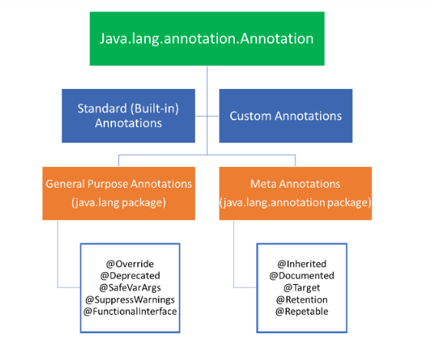
Java Annotations
Annotations in Java provide additional information to the compiler and JVM.
An annotation is a tag representing metadata about classes, interfaces, variables, methods, or fields.
Annotations do not impact the execution of the code that they annotate

Slide 4
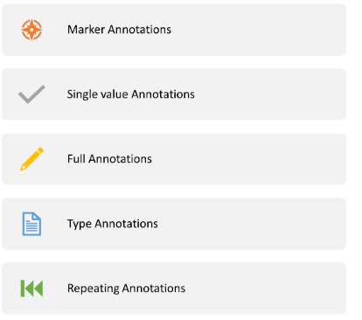
Annotation Types

Slide 5
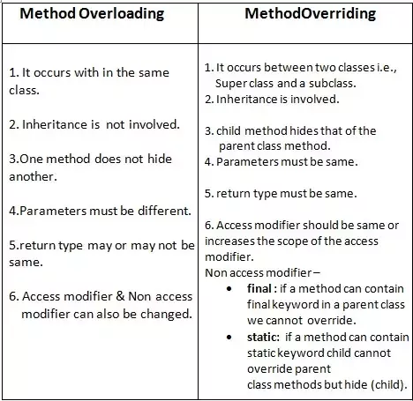
Method Overloading Vs. Method Overriding

Slide 6
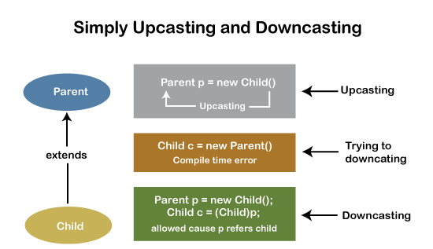
Upcasting and Downcasting

Slide 7
instanceof operator
Java provides a binary operator called instanceof which returns true if an object is an instance of a particular class. The syntax is as follows
anObject instanceof aClass
Circle c1 = new Circle();
System.out.println(c1 instanceof Circle); // true
if (c1 instanceof Circle) { ...... }

Slide 8
Abstract classes and Methods
We use the abstract keyword to create abstract classes and methods.
An abstract method doesn't have any implementation (method body).
A class containing abstract methods should also be abstract.
We cannot create objects of an abstract class.
To implement features of an abstract class, we inherit subclasses from it and create objects of the subclass.
A subclass must override all abstract methods of an abstract class. However, if the subclass is declared abstract, it's not mandatory to override abstract methods.
We can access the static attributes and methods of an abstract class using the reference of the abstract class.

Slide 9
Final Keyword
The final modifier applies to classes, methods, and variables. The meaning of final varies from context to context, but the essential idea is the same.
A final class cannot be inherited
A final variable becomes a constant and its value cannot be changed.
A final method cannot be overridden. This is done for security reasons, and these methods are used for optimization.

Slide 10
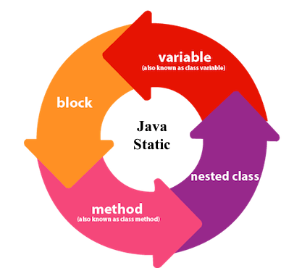
Static keyword

Slide 11
Static Blocks
If you need to do the computation in order to initialize your static variables, you can declare a static block that gets executed exactly once, when the class is first loaded.
It is executed before the main method at the time of class loading.
Can have multiple static blocks
Static blocks can access only static variables

Slide 12
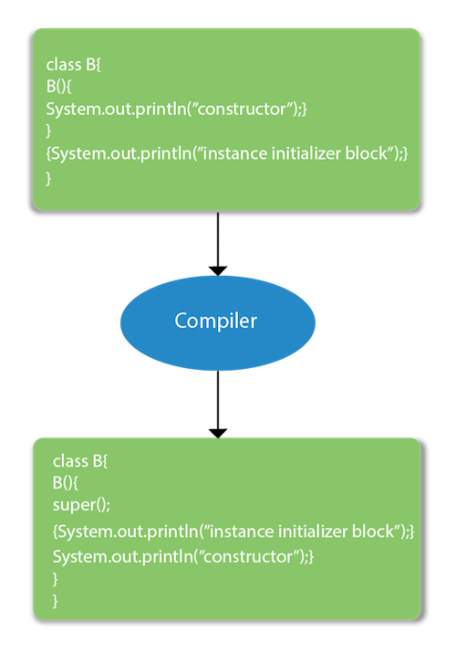
Instance Initializer Block
There are mainly three rules for the instance initializer block. They are as follows:
The instance initializer block is created when instance of the class is created.
The instance initializer block is invoked after the parent class constructor is invoked (i.e. after super() constructor call).
The instance initializer block comes in the order in which they appear.

Slide 13
Static Variables
When a variable is declared as static, then a single copy of the variable is created and shared among all objects at the class level.
Static variables are, essentially, global variables. All instances of the class share the same static variable.
We can create static variables at the class level only
Static blocks can access only static variables

Slide 14
Static Methods
They can only directly call other static methods.
They can only directly access static data.
They cannot refer to this or super in any way.
Cannot be abstract
Can overload

Slide 15
Interfaces in Java
An Interface in Java programming language is defined as an abstract type used to specify the behavior of a class.
An interface in Java is a blueprint of a behaviour.
A Java interface contains static constants and abstract methods.
A Java class can implement multiple Java Interfaces. It is necessary that the class must implement all the methods declared in the interfaces.

Slide 16
Interface Facts
A Java class can implement multiple Java Interfaces. It is necessary that the class must implement all the methods declared in the interfaces.
Class should override all the abstract methods declared in the interface
The interface allows sending a message to an object without concerning which classes it belongs.
All methods in an interface are implicitly public and abstract
An interface cannot be instantiated
An interface reference can point to objects of its implementing classes

Slide 17
Interface Facts
An interface can extend from one or many interfaces. Class can extend only one class but implement any number of interfaces
An interface cannot implement another Interface. It has to extend another interface if needed.
An interface which is declared inside another interface is referred as nested interface
At the time of declaration, interface variable must be initialized. Otherwise, the compiler will throw an error.
The class cannot implement two interfaces in java that have methods with same name but different return type.
Interface can contain private methods

Slide 18
Java 8 Interface Default Method
The reason we have default methods in interfaces is to allow the developers to add new methods to the interfaces without affecting the classes that implements these interfaces.
default void newMethod(){
System.out.println("Newly added default method");
}
Can have more than one default methods
Can override Default Methods

Slide 19
Java 8 Interface static Method
The static methods are defined inside the interface and they cannot be overridden or changed by the classes that implement this interface.
We can call these static methods by directly using the interface name.
//interface declaration interface TestInterface { // static method definition static void static_print() { System.out.println("TestInterface::static_print ()"); } // abstract method declaration void nonStaticMethod(String str); }

Slide 20
Java Functional Interface
An Interface that contains exactly one abstract method is known as functional interface.
It can have any number of default, static methods but can contain only one abstract method. It can also declare methods of object class.
Functional Interface is also known as Single Abstract Method Interfaces or SAM Interfaces.
@FunctionalInterface
interface sayable{
void say(String msg);
}

Slide 21
Java Marker Interface
An interface that does not have any methods, fields, or constants, i.e, an empty interface in java is known as Marker or Tag Interface.
It is used to deliver type information at runtime to the JVM so that it can take some action based on the information received.
One of the main purposes behind the ideology of marker interfaces is that they are used to convey a message to the JVM that the class implementing this type of interface has some extra functionalities.
Popular examples of marker interface in java include Cloneable, Serializable, Remote Interface.

Slide 22
THANK YOU !!!
AMOL - 9822291613

